Slide 1

Chapter 1, Part 1
Database Systems
Notes:
The slides in this presentation have been adapted from slides provided with the textbook, Database Systems: Design, Implementation, and Management, 12E, Cornel and Morris, Copyright © 2017 Cengage Learning.

Slide 2
Learning Objectives
The difference between data and information
What a database is, the various types of databases, and why they are valuable assets for decision making
How modern databases evolved from file systems
Copyright © 2017 Cengage Learning
2

Slide 3
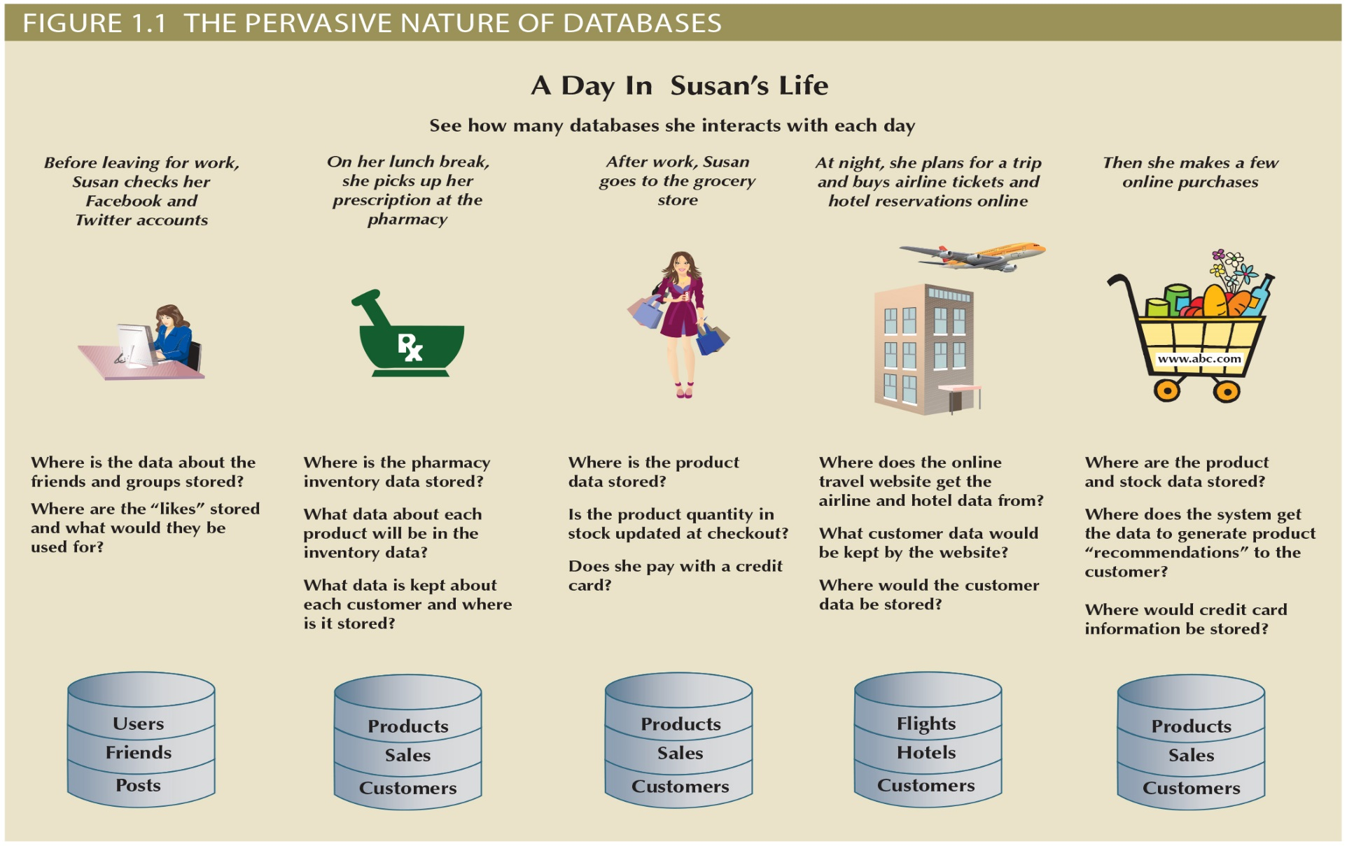
You Use Databases Many Times each Day
Copyright © 2017 Cengage Learning
3

Slide 4
Data vs. Information
Data
Information
Raw facts
Raw data - Not yet been processed to reveal the meaning
Building blocks of information
Data management
Generation, storage, and retrieval of data
Produced by processing data
Reveals the meaning of data
Enables knowledge creation
Should be accurate, relevant, and timely to enable good decision making
Copyright © 2017 Cengage Learning
4

Slide 5
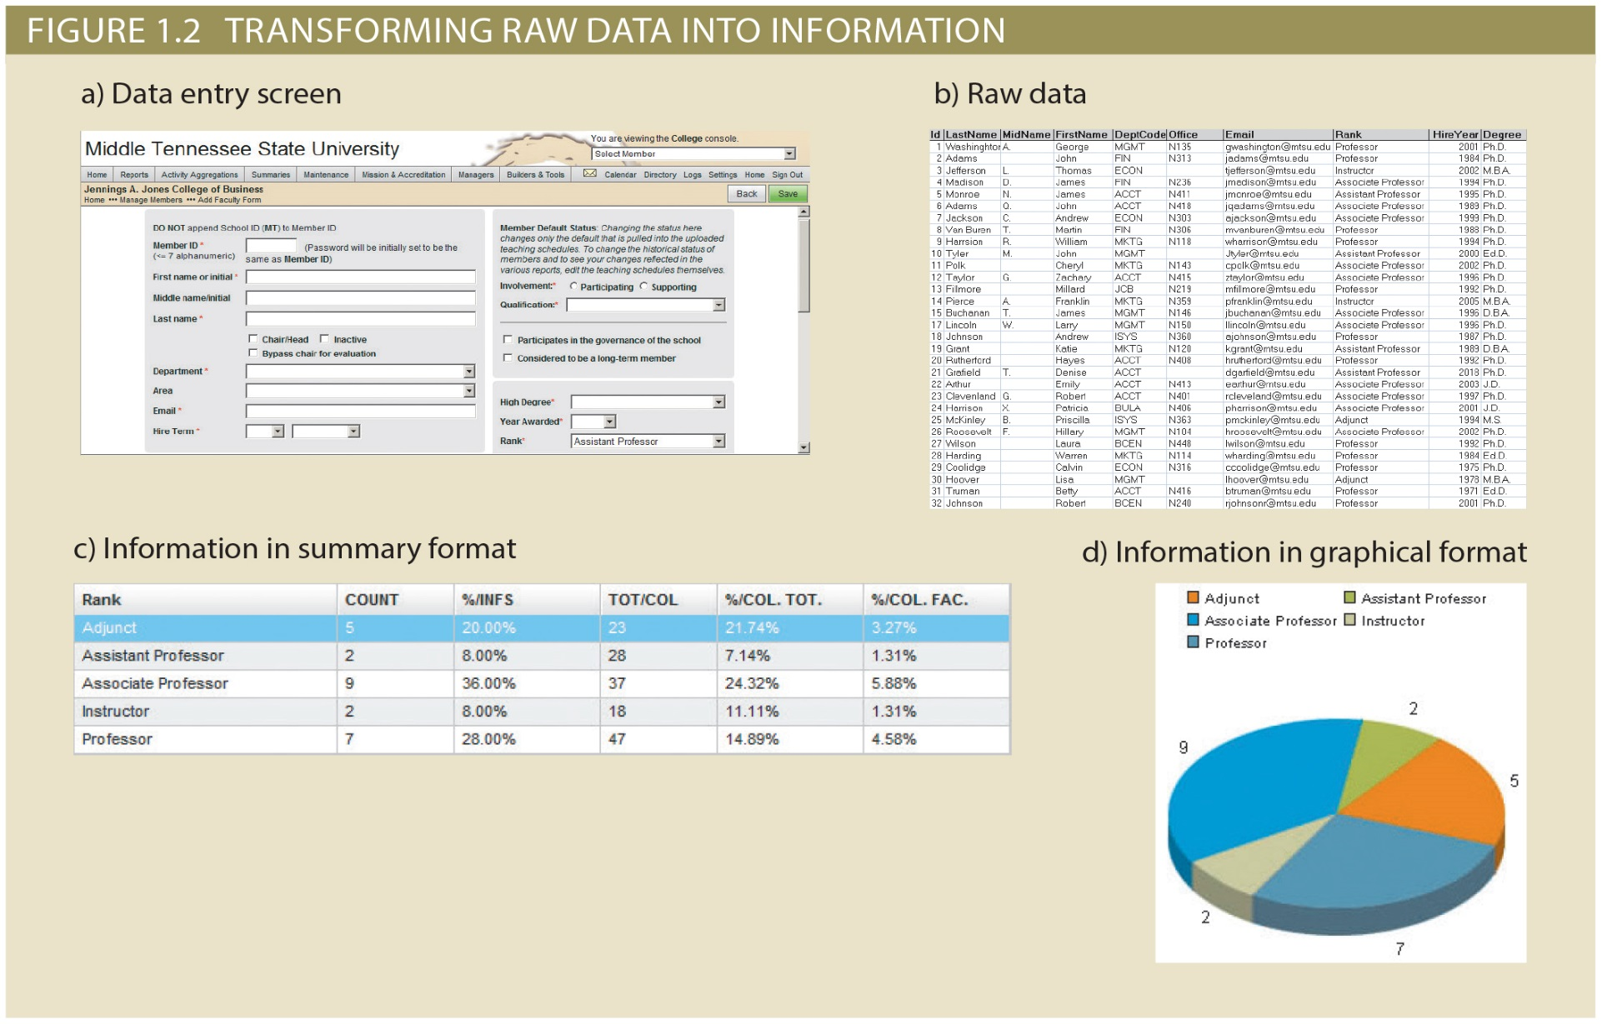
Data vs. Information
Copyright © 2017 Cengage Learning
5

Slide 6
Database
Shared, integrated computer structure that stores a collection of:
End-user data: Raw facts of interest to end users
Metadata: Data about data, with which the end-user data are integrated and managed
Database management system (DBMS)
Collection of programs
Manages the database structure
Controls access to data stored in the database
Copyright © 2017 Cengage Learning
6

Slide 7
Role of the DBMS
Intermediary between the user and the database
Enables data to be shared
Presents the end user with an integrated view of the data
Receives and translates application requests into operations required to fulfill the requests
Hides database’s internal complexity from the application programs and users
Copyright © 2017 Cengage Learning
7

Slide 8
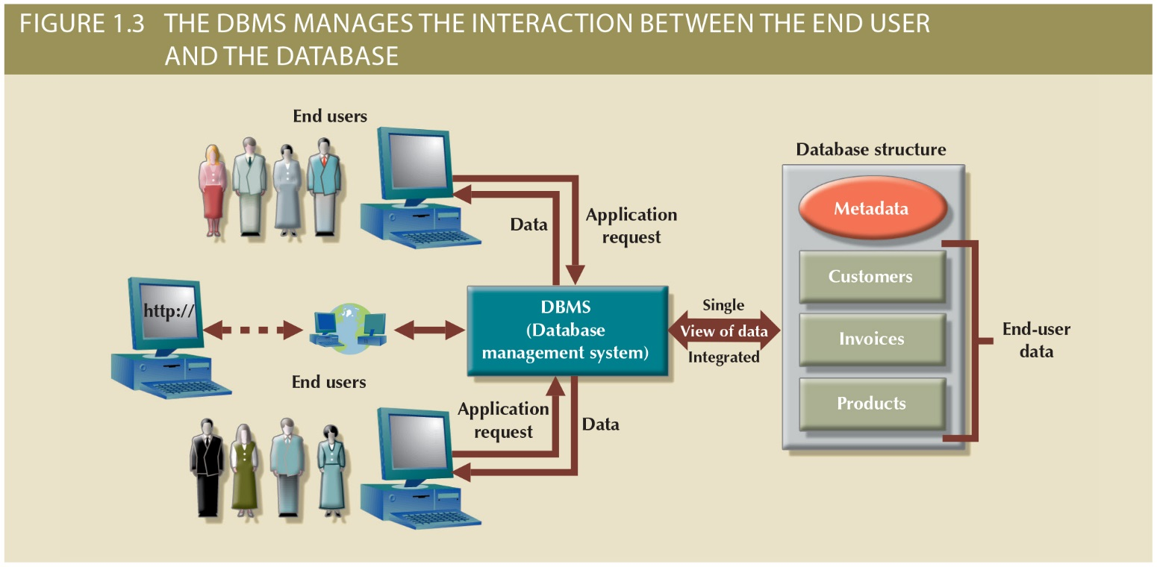
Figure 1.3 - The DBMS Manages the Interaction between the End User and the Database
Copyright © 2017 Cengage Learning
8

Slide 9
Advantages of the DBMS
Better data integration and less data inconsistency
Data inconsistency: Different versions of the same data appear in different places
Increased end-user productivity
Improved:
Data sharing
Data security
Data access
Decision making
Data quality: Promoting accuracy, validity, and timeliness of data
Copyright © 2017 Cengage Learning
9

Slide 10
Types of Databases
Single-user database: Supports one user at a time
Desktop database: Runs on PC
Your Projects in this class.
Multiuser database: Supports multiple users at the same time
Workgroup databases: Supports a small number of users or a specific department
Enterprise database: Supports many users across many departments
Copyright © 2017 Cengage Learning
10

Slide 11
Locations of Databases
Centralized database: Data is located at a single site
Distributed database: Data is distributed across different sites
Cloud database: Created and maintained using cloud data services that provide defined performance measures for the database
Copyright © 2017 Cengage Learning
11

Slide 12
Uses of Databases
Operational database: Designed to support a company’s day-to-day operations
Grocery Store, Insurance, Medical Records, Customer Management
Analytical database Stores historical data and business metrics used exclusively for tactical or strategic decision making
Data warehouse: Stores data in a format optimized for support of specific decisions to be made
Copyright © 2017 Cengage Learning
12

Slide 13
Types of Data
Unstructured data: It exists in their original state
Tweets, Blogs, Real Estate Contracts
Structured data: It results from formatting
Structure is applied based on type of processing to be performed
Driver’s License or Vehicle Title or Registration
Multiple Listing Service (MLS) Real Estate Data
Semi-structured data: Processed to some extent
Tweets processed for positive/negative sentiments toward a news topic
Copyright © 2017 Cengage Learning
13

Slide 14
Database Design
Focuses on the design of the database structure that will be used to store and manage end-user data
Well-designed database
Facilitates data management
Generates accurate and valuable information
Poorly designed database causes difficult-to-trace errors
Copyright © 2017 Cengage Learning
14

Slide 15
Evolution of File System Data Processing
Manual File Systems
Accomplished through a system of file folders and filing cabinets
Computerized File Systems
Data processing (DP) specialist: Created a computer-based system that would track data and produce required reports
File System Redux: Modern End-User Productivity Tools
Includes spreadsheet programs such as Microsoft Excel
Copyright © 2017 Cengage Learning
15

Slide 16
Summary
Data are the facts about that situation that are stored in the database.
Information for decision making is created by processing, e.g., summarizing or graphing the data
A DBMS is a collection of programs that manage a database.
Databases can be on your desktop, in a central site, distributed across many sites, or in the cloud.
You use and provide data every day.
Copyright © 2017 Cengage Learning
16

Slide 17
Task
Identify three situations from your day today where you have likely provided data that was stored in a database:
1: ___________________________________
2: ___________________________________
3: ___________________________________
Copyright © 2017 Cengage Learning
17

